Slide 1
Example: RailCo Ltd.
It started out as a brokerage for various railway wholesalers, but then came to specialize in air brakes.
– The narrowed business focus resulted in increased opportunities, as RailCo was able to become a wholesaler in its own right by dealing directly with air brake parts manufacturers.

Slide 2
RailCo's automated environment
Outdated technology
A two-tier client-server system governing all accounting and inventory control transactions.
Two administrative clerks manually feed this solution with standard transaction document data (primarily incoming and outgoing purchase orders and invoices).
Receipt and submission of these documents typically initiates
corresponding inventory receiving and order shipping processes.
A contact management system in which customer and business partner profile information is stored and maintained.
This simple application consists of a database fronted by Web- based data entry and reporting user-interfaces.
Users range from managers to administrative assistants and accounting personnel.

Slide 3
Observed Problems
Profit margins have been noticeably declining over the past year.
Clients have been switching to a competitor providing the same products in a more efficient manner and at a lower cost.
Further investigation led to the discovery that this competitor has implemented an extension to their existing accounting system, allowing them to perform various transactions online via B2B solutions provided by some of the larger clients.
A further unpleasant revelation was that RailCo's primary client, Transit Line Systems, has started an online relationship with this competitor as well.
RailCo is a company with outdated technology automating
inefficient business processes.
Need to better respond to new business trends and automation requirements.

Slide 4
RailCo problems
RailCo's original goals
upgrade its automation systems
remain competitive
continue its business relationship with its primary client, TLS.
RailCo had lost TLS as a customer when a competitor managed to provide air brake parts at a lower price while also interfacing with TLS's B2B system.

Slide 5
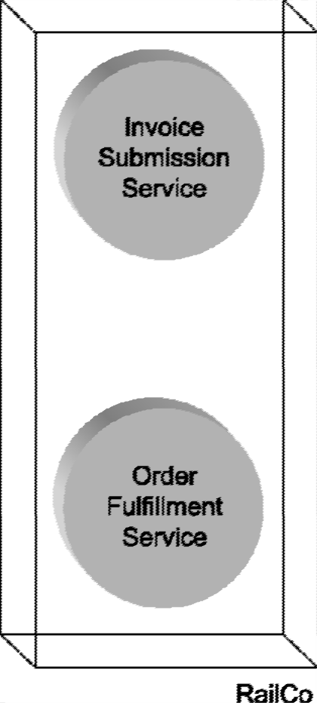
To remain competitive and minimize losses, RailCo must upgrade its automation environment as soon as possible. Its top priority is to participate in online transactions with TLS. Before our storyline begins, RailCo has already hurried to build a pair of Web services
Figure 2.1: RailCo’s initial set of Web services, designed only to allow RailCo to connect to TLS’s B2B solution.
RailCo-to-TLS Invoice Submission and the TLS-to-RailCo Purchase Order Submission Processes

Slide 6
RailCo – initial services
RailCo rushed to catch up, producing a pair of Web services designed only for use with the TLS system.
This allowed RailCo to regain its position as a TLS vendor.
These two initial Web services were
Invoice Submission Service
Order Fulfillment Service
(Another service was added later to interact with the TLS Notification Service.)
RailCo’s initial set of Web services, designed only to allow RailCo to connect to TLS’s B2B solution.

Slide 7
RailCo case example - summary
RailCo realised that it was loosing their clients to their competitor
To prevent loosing their primary client, Transit Line Systems (TLS), they decided to build a pair of Web Services to participate in online transactions with TLS
RailCo-to-TLS Invoice Submission Process
TLS-to-RailCo Purchase Order Submission Process
Figure 2.1: RailCo’s initial set of Web services, designed only to allow RailCo to connect to TLS’s B2B solution.

Slide 8

Multiple Choice(single)
Points: 1
Based on the information given in the case, RailCo constructed their services based on which approach?
A
Bottom-up
B
Top-down
C
Agile
Submit

Slide 9
RailCo bottom-up Web services construction results
The services were assembled quickly, to accommodate a single client
The services were delivered to accommodate a specific need
fulfilled immediate business requirements
Efficient
Cost-effective
Initially considered successful

Slide 10
However, very soon RailCo needed to respond to multiple changes
TSL implemented a new policy that affected some of the purchase order business logic on RailCo’s end
RailCo’s own internal business process underwent a change as a result of a module upgrade within their legacy accounting system
Affected low-level data access parameters processed by the RailCo Invoice Submission Service
Other RailCo’s legacy systems that interfaced with their Web services also underwent changes
Numerous changes were made to existing automation processes

Slide 11
Discussion
Each of the changes in numerous systems interfacing with RailCo’s Web services affected multiple services
These services needed to be redeveloped
What challenges do you see in redeveloping the Web services constructed based on bottom-up approach?

Slide 12
Redeveloping web services challenges
A significant redevelopment effort
There was no separation of business and application logic
Change impacted a broader part of their solution environment
None of the services were reusable
Less chance that the new requirements could be fulfilled by existing services
With each programming modification came the overhead
Testing and development phases

Slide 13
RailCo decides to start from scratch
The agile delivery strategy is chosen
Only application and business service layers will be modeled (cannot afford to invest in the middleware required to implement an orchestration layer)

